Slide 1
Q fundamentals.
What is Q ?
History of kdb+/q.
Column oriented vs row oriented databases [ traditional relational databases ].
Frequently used terminology.
q
qSQL
Timeseries Database.
KDB+
Tick Database.
Array Language.
Expressive, terse and mathematical.
In memory vs on disk databases [ Traditional ] processing.

Slide 2
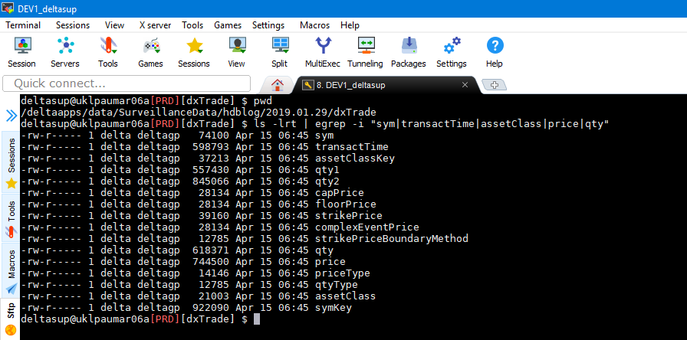
q is a powerful array programming language based on K. It is functional, expressive and terse in nature. It is primarily suited for large scale data analysis. The analysis is primarily dependent on in memory processing.
q was developed by Arthur Whitney around 1993 initially as K programming language inspired by APL. Kdb+ database was developed initially around K. To improve end user readability and expressiveness of the code q language was introduced as wrapper around K around 2003.
Kdb+ is a column oriented database. This provides significant opportunities for performance improvement in array style data processing. The traditional relational databases are row oriented and have limitations on performance. This becomes critical and differentiating factor when the data is large scale. Ex:- timeseries data. Below is a simple example to illustrate this.
Ex:- dxTrade has 153 columns. Assume we only need sym, date, assetClass, price and qty.
A row oriented RDBMS storing this table by index on sym and date would store the entire row data in single block on the disk. Even if a few columns are required the entire row [ block of data ] has to be read from disk and then filtered in memory for required columns. disk reads [ seeks ] are costly. This reading by entire row block is inefficient. Even to parse and find offset of columns that are needed on disk seek is required.
VS
A column oriented database on the other hand stores each column separately as an array or list on the disk. This helps in reducing the cost or overhead of extracting the data for only required columns. The below diagram illustrates this in more detail.

Slide 3
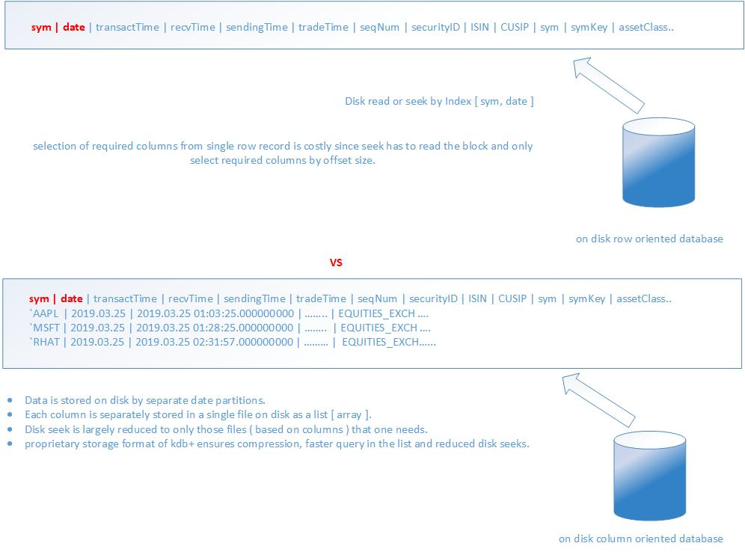

Slide 4
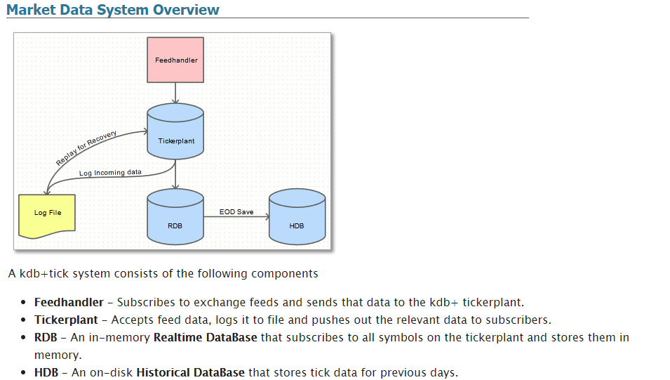
A brief on terminology.
q is readable, user friendly language that sits on top of K programming language. It is the language that the developers use.
qSQL is the sql like part of the q language. It is not strictly compliant to sql syntax. But closely resembles it in most of basic cases.
A time series database is a database that is stores primarily around precision time data and associated event attributes.
KDB+ is the tick database framework. It is the underlying framework written using q with different components and processes that allow one to capture real time data and store it for further analysis. A kdb+ tick database has below components all of which are generally mandatory.
Feed handler.
Ticker plant process.
Ticker plant on disk log.
Ticker Plant subscribers [ RDB and other in memory processes. RDB is primarily meant for storing current business day data in memory ].
HDB [ on disk database that stores each business day data separately under dated folder on disk for historical analysis ].

Slide 5
An array language is a programming language that is specially designed for processing array or list style data as efficiently as possible. It is designed with the central idea that most of the language operators can work with single piece of data or array of the same.
Ex:- 1 + 2 equals 3 , but 1 2 3 + 4 5 6 is also valid. Here the result is 5 7 9
One of the key features of q is that one has to write very little code to solve complex problems.
Ex:- The code to calculate standard deviation is simply { b:sum { xexp[x-y;2] }[; avg x] each x; sqrt b%count x }
Note :
Don’t get intimidated by the syntax of the language. Once you get the hang of the basics it indeed is very easy to understand.
Q Gods believe that code needs to be as little as possible. Q Gods don’t debug because they don’t do mistakes ☺.
Debugging q code is harder than other languages since it is interpreted and errors are not user friendly.
Don’t worry!! The good news is there are tools to help debug the code and analyze the standard errors.
We will explore these errors and general approach to investigate these issues later.
Couple of key points to note regarding in memory databases below.
In memory databases perform faster because computation in RAM is way faster than computation on disk [ disk IO << memory IO ].
Falling cost of memory technology enables one to have large size memory capacity.
Real time mission critical applications which need ultra fast latency sensitive performance are more suited for design using in memory databases.
They are good replacements for traditional cache technologies.
Still ……..
In memory databases are not a panacea for poor design , inefficient code. One still has to get the data and core design accurate.
Scaling more memory is not helpful if good design principles are not followed.

Slide 6
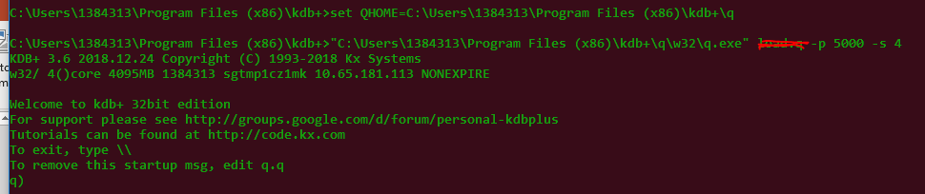
Setting up q for development on machine.
q website , license model and free developer download edition.
www.kx.com
https://kx.com/connect-with-us/download/ [ Use this link for free non commercial 32 bit download ( windows ) ].
Recently there is a 64 bit personal edition with on demand license available free of cost!. This is meant for non commercial development and use in academics.
setting up a q process on local machine with a port.
Here we will choose port number as 5000.
We will assume that the user has below folder where he can deploy the q downloaded binary. Ex:- C:\Users\PSID\Program Files (x86)\kdb+\
Create a file called run5k.cmd in the above folder with below content. Save it and execute it.
@echo on
set QHOME=C:\Users\PSID\Program Files (x86)\kdb+\q
"%QHOME%\w32\q.exe" -p 5000 -s 4
When we run the above bat file we should see something like below. It is a q prompt that is ready to receive commands.
To Test if the q process is working type 1+1 and check if it prints 2 and returns to the q) command prompt.

Slide 7
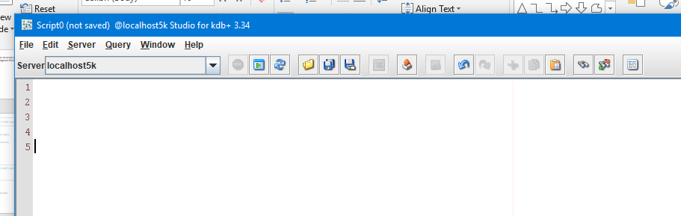
Setting up q continued….
The thing with q command prompt is that its very simplistic and minimal in nature.
There are some limitations of working from command prompt like displaying large table with more 50-60 rows.
Hence generally a q client or IDE [ Graphical development client ] is preferred for doing effective development.
Many options to choose from. Ex:- kdb+ studio by Charles skelton, qPad and delta control IDE.
Personally preference here. I generally recommend using kdb+ studio since it is free and minimal. Requires java to run.
Download or copy from S:\Admin\Users\Anand\software\kdb-studio to local directory C:\Users\PSID\Program Files (x86)\.
Create a shortcut on desktop or your area of preference for the run.cmd batch file.
Execute the run.cmd file. Accept any license notification/agreement [ not without reading!! ]. We should see a screen like below.
Now click on Server -> Add. Enter these parameter values { Name : localhost5k or whatever you like ; Host : localhost ; Port : 5000; }. Click ok.
You have kdb+ client set up and ready now. To test you can enter 1+1 and see if the result is 2. We will describe what is actually happening now in slight detail. The kdb+ studio is interacting and sending the commands you enter in the GUI to the q process running in background terminal over port 5000. The results are fetched and displayed with proper formatting on the results tab.
Now we are setup and ready to go. We will start with the fundamentals.

Slide 8
Q basics
Atoms.
Data types.
Variables.
Constants.
Complex or derived data types.
Maps / dictionaries.
Lists or arrays.
Tables [ keyed and non keyed ].
type safe [ type strict ] vs non typed languages.
Functions / lambdas.
Adverbs.
Logical operators.
Math operators.
Some special operators.
@, $, !, ?, ~, #, _ and ^.
Casting data from one type to another.
Some exercises.
Implement VWAP Logic.
Build a generator that generates list of pairs of form ( x^2+1 , x^2-1 ). Write lambda to achieve this.
Write a lambda to find common elements of two lists.

Slide 9
Q Basics continued…
Atom is a single value of certain data type. Ex:- 16i is an integer atom, 16.543f is float atom.
Choice of datatype depends on nature of the problem and sometimes also how efficient memory usage is required!.
Each datatype requires a certain number of bytes to store in memory. Hence judicious choice of datatype for atom is important.
https://code.kx.com/v2/ref/ has a very good and comprehensive section on datatypes. Refer the same.
Each datatype has
A type code which is hex variable returned.
A specific short and long name represented as string , symbol in kdb+.
A specific memory requirement in bytes allocated.
Variables are any names that store value. A variable generally holds a value of certain data type. It can also store a complex type ( ex: table ).
Ex:- p:10j [ stores a long type data with value 10 into variable called p.
Ex:- today:.z.D [ stores a date type of date into variable called today. It specifically here stores todays date ].
Ex:- ourTeam:”caliberationTeam”. This assigns a string value into a variable here called ourTeam. Note that a string is a list of characters.
There are rules around proper variable names. Ex:- 123abc is an invalid variable name. variable names have to start with letter and can be alpha numeric ex:- abc_123:100j is valid. Explore https://code.kx.com/q4m3/1_Q_Shock_and_Awe/#12-variables for details on choosing proper variable names. Below are some good rules.
Use camelCasing and meaningful variable names. Ex:- percentileTable is a good name. p,t,v are not good names as they are not meaningful.
Don’t use very long verbose variable names. Try to keep it with 10-12 characters as much as possible.
Avoid special characters in variable names. Ex:- tableSizeInfo#$% is bad.

Slide 10
Q Basics continued…
A constant is any value that does not change. Ex:- `anand , “anand”, 100j, 3.14159f. These are constant values because they are fixed and cant themselves change. This is opposite behavior to what variables are which can change what they store during their life time. All the above constants are of different data types. Generally a good practice is to assign the constants required to all capitals named variables and use in the code further. Note that PI can still be amended as it is a variable!! It is up to discipline of the programmer to avoid doing this since it will never change in value.
Ex:- PI:3.14159f and can be used in the code like below.
getCirclePerimeter:{ 2*PI*x } / here x is parameter passed to the function which is the radius of the circle.
A complex or derived data type is a more advanced data structure that is designed to store data in certain way to enable complex operations. Ex:- A list of a collection of items.
Ex:- sampleIntegerList: 100 200 350 472;
Ex:- sampleIntegerList: 100 200 350 472; tsaScriptingTeamMembers:`anand`beni`rod`nick;
There are mainly below types of complex data types.
Lists.
map or dictionary.
Tables [ keyed and non keyed ].
All problems are generally solved via searching, sorting and filtering! These are basic building blocks of all problem solving!
These complex data types help us manage and model problems and solve them efficiently. Let us look at some examples in next section.

Slide 11
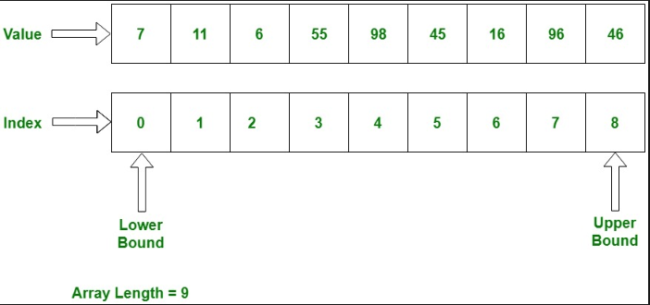
Q Basics continued…
A List is simply a collection of items of similar type, generally more than 1 item in the collection. List : Item1, Item2, Item3;
All items in the list are stored contiguously in the memory. Hence the items can be accessed efficiently.
Lists can grow in size depending on how many items are there in them.
Two special cases exist for list namely a list with single value and an empty/null List.
The List with single value is generally represented as enlist item.
Ex:- mySingleItemList:enlist 100.2f; Here the mySingleItemList contains one item of float type.
myScoresList:12 17 124 789 523i / This is a list of integers. It is a proper list since it has more than 1 item.
An empty list is a special list case where it has no items. This can happen and may be required in certain programming edge cases. Ex:- two sets may have nothing in common and their common set value will simply be an empty set. It can be represented via null List.
One of key benefits of a list is that any of its items can be accessed using index number directly.
Ex:- myScoresList:12 17 124 789 523i; secondScore : myScoresList[1].
Why the index here is 1 ? This is because the index of first element of an array or List is zero not 1. This is the standard approach in programming generally.
The below picture represents the List and how it is stored in memory.
Any questions on List ?
Exercises on List. Try below examples.
Given a list identify all elements which are perfect squares.
Given a List identify return only the odd variables from the List.

Slide 12
Q Basics continued…
A map is a data structure that allows key value pairs to be stored in efficient way so that accessing the value of a given key is very efficient.
A map can be thought of or considered similar to look up dictionary that is sorted by the words [ keys ].
In q a map can store value of either a simple type or a complex derived type [ Ex:- List ].
Technical Fact : The lookup cost of an item in a map is O(log2(n)) if implemented using BST or O(1) if it is HashMap lookup.
A map is represented in q as (keyList)!(valueList). Ex:- myTestMap:`Anand`Beni`Rod`Nick!10 20 30 40;
Ex:- In order to access `Anand value in the map we do the below.
anandAge:myTestMap[`Anand] or you can even generalize it like username: `Anand; userAge : myTestMap[username];
Maps are very useful to lookup data. They are often used as cache in applications.
A Key in a map is always unique [ and should be in a good design ]. Duplicate keys will result in only the first value being retrieved.
myDict : (`Anand`Albert`Anand`Peter`Thomas)!(10 20 30 40 50);
anandAge:myDict[`Anand]; / Here anandAge is 10 not 30 since the only first occurance is returned.
A map can also be looked at as two Lists of same length kept side by side.
Ex:- myDict : (`Anand`Albert`Anand`Peter`Thomas)!(10 20 30 40 50);
keyItemsList:key myDict; / The keyItemsList is `Anand`Albert`Anand`Peter`Thomas.
valueItemsList:value myDict; / The valueItemsList is 10 20 30 40 50.
Something to think about.
How will you implement a multi map where each key can have one or more value ?
Is a List also a kind of map ?

Slide 13
Q Basics continued…
A table in kdb+ is essentially a collection of named columns implemented as a dictionary.
Think of a table as multiple named lists kept side by side which looks as two dimensional array.
Each column in a table is a List of values with column name as property or attribute.
Ex:- sampleTable : ([] Name:`Anand`Peter`Thomas`Robert`James; Salary : 1 2 3 4 5);
To access the first column in the table one can do it either of the way below.
nameList : sampleTable[`Name];
nameList : sampleTable.Name;
The table can also be accessed row wise.
firstRow : sampleTable[0]; / surprise! It returns a dictionary of column names and values in specific row.
Since a table is an aggregate of row wise dictionary data , it is no surprise that if we flip a dictionary we should get a table.
Ex:- testable : flip firstRow; / firstRow is initialized in above example. It will return a table of 1 row.
If a table has multiple rows we can see that each row dictionary flipped and merged together will return the original table itself. We can verify this fact as below.
sampleTable : flip `name`iq!(`Dent`Beeblebrox`Prefect;98 42 126);
firstRow : sampleTable[0]; / This is a dictionary.
newTable : { y[x] }[;sampleTable] each til count sampleTable; / Take each row dictionary of the table and merge them.
newTable ~ sampleTable / Returns 1b because they are same!!
Some useful tools for exploring tables.
meta sampleTable; / This returns the layout of the table. There columns exist for each column name as a row. t -> type , f -> foreign key , a -> attribute.
cols sampleTable; / Gives a list of column names as symbols for a given table.
keys sampleTable; / List of key columns in a table. If the table is unkeyed then its an empty List. The result is list because multiple columns can be used as key.

Slide 14
Q Basics continued…
There are two kinds of table based on classification criteria of if it has keys. Keyed tables and non keyed tables.
A non keyed table is a table without any key columns. In real world most of the schema design requires keys on a table. Although non keyed tables can still exist and useful. A non keyed table type is 98h.
sampleTable : ([] Name:`Anand`Peter`Alex;Age:10 20 30); / This table does not have any key this is why it has [] at the start.
Try the below commands to verify some details about the non keyed table.
type sampleTable / should return 98h since it is unkeyed table.
keys sampleTable / this should be an empty symbol List since this is unkeyed table it has no key columns.
A Keyed table is a table which has single or composite primary key. So what are the reasons to use key, its implications ?
A simple keyed table has one column which acts as primary key for the table.
A composite keyed table has multiple columns [ 2 or more ] which act as primary key for the table.
A primary key is the most frequent criteria by which data is queried in the table and is generally unique [ but not mandatory ].
Internally since primary key column(s) act as the lookup criteria , it is no surprise that a keyed table is a dictionary with key columns as the lookup key and the rest of the columns as the attribute data or values in dictionary.
Internally Q will try to build a unique hash for each key and help in faster lookup of data. If each key is unique then the lookup is done via hashmap and is O(1) operation. Very fast!!
If there are duplicates in key column then generally it indicates a sub optimal or bad design. It can also cost more time in lookup of data or query times on the table.
Some useful facts about keyed tables are detailed below.
sampleTable : ([Name:`Anand`Peter`Alex];Age:10 20 30); / This table is keyed on column Name.
type sampleTable / This should return 99h is the table is keyed. 99h is also the type for a dictionary. They are same internally!!
keys sampleTable / This should return the key List for the table.

Slide 15
Q as a type less language.
q is a type less or non type strict language.
This means that a variable can change at any moment its data type underneath transparently without any bottleneck of declaration. This is unlike other type strict languages Ex:- C++, Java.
Below example demonstrates the same. It is a lambda that takes in a table, a column name, a condition criteria and returns the list of column values that satisfy the criteria. This is bit involved but we can step by step walk through the code.
employeeTable:([] Name:`Anand`Peter`Thomas`Robert`Nick; age:10 20 30 40 50);
testFunc:{[inputTable;inputColName;inputCondition]
t:?[inputTable;enlist inputCondition;0b;{x!x} enlist inputColName]; / t is a sub table or view on main table.
t:?[t;();();inputColName]; / Here t becomes a list of the column type requested.
t / return the list from function
}
testFunc[employeeTable;`Name;(>;`age;20j)] / This returns a list of Name whose age is greater than 20. Namely `Thomas`Robert`Nick.
One can see here that t variable inside the function is initially a table and later assume a list and returns a list. Variables are not hard bound to a given type during their existence.
Another example is below.
sampleLongList : 10 20 30 40 50j;
sampleLongList : $[`float; sampleLongList]; / Now sampleLongList becomes a float list. Each value in this is a float type now not long integer type.
What happens to memory alignment and size when datatype change for a variable ? The previous value is kept ready for garbage collection and list assumes new values stored at a different memory location.

Slide 16
Q Basics continued…
Functions or lambda in q are convenient way of writing sub routines of methods that accomplish a given task. They can return a value or return nothing. It is optional and left to the programmer to design and implement properly.
The syntax of a lambda is below. All pieces are mandatory.
functionName:{[inputParam1; InputParam2; …..inputParamN ]
/ Comments here.
/ Another line of comment.
/ Each statement must end with semi colon.
A:12;
B:24;
T:A+B;
……..
/If result is required it is returned as below. Assume result is in t.
T
/ If result is not required to be returned then simply don’t do anything.
} / Closing brace.
The function parameters are optional and default function parameters can be passed. They are always called x, y and z. only maximum of three parameter are allowed via default variable names.
Refer to the Q manual to know maximum number of parameters allowed. It is 8. How will you pass if more ?
Answer : ???
In the next section we will explore some useful examples to understand building lambdas.
summation:{ x + y + z } / This function will add 3 numbers taking the first 3 parameters passed. Using default variables!!
myAvgFunc:{[inputList] sum inputList % count inputList } / myAvgFunc[1 2 3 4 5]
dotProductFunc:{ sum x * y } / This is floating product essentially multiplying items at same index and adding of those results.

Slide 17
Q Basics continued…
Lambda can be passed as an argument to another lambda function. This is very useful. Ex:- I am not sure which operation to do on two numbers passed and expect the caller of the function to specify and pass the function at run time.
Ex:- The below Example indicates this concept.
myGenericLambda:{[inputFunc;inputParam1;inputParam2] inputFunc[inputParam1;inputParam2] }
myGenericLambda[{ x + y}; 1; 2] / This will return 3 since the first parameter passed is a addition function.
myGenericLambda[{ sum x * y }; 1 2 3f; 2 3 4f] / This will return dot product of the two float lists passed.
Maximum number of local variables permitted in lambda is 24.
Maximum number of global variables permitted in lambda is 32.
There are two kinds of scopes available for a variable in Q. a variable with same name can exist at global scope and one at local scope.
There is no nested scope level available in Q as for as accessing it is concerned .Either you can refer to the local variable or the global scope. Intermediate scope levels are not accessible. Below example illustrates this.
a:100j;
testFunc:{[]
/ Assign the same variable with a value of 150 now.
a:150j;
/ We call another function now within. one the fly lambda or anonymous function [ i.e function with out a name ].
res:{[]
a:200j;
/ Now try accessing the global value of a.
(@[value; 'a]; a) / This will return the 100j which is set at global level. You cant access 150 from here which is one scope level above this lambda.
}[];
(res; a)
}
testFunc[] / Output is (100 200j;150j)

Slide 18
Q Basics continued…
Adverbs are powerful idioms of q which allow to do special processing functions over array or list input data. Think of them as generators.
The most commonly used adverbs are scan , over, each prior, each left and each right.
We start with scan function. It is denoted by the operator \.
scan applies a given lambda of given valence over input data and produces result List at intermediate levels and returns the same. The operation is executed till it converges i.e the function stops producing new result on further iterations.
some terminology again to avoid confusion. Lambda is a function ( we already know ).
valence of a function is the number of parameters required to run that function. Ex:- addition has valence of 2 because to add it requires atleast 2 parameters. The valence of a square function is 1. because minimum one input is required to square it.
There are three variations of scan. Monadic (1 ) , dyadic (2) and polyadic(>2). The numbers in the () indicate valence.
scan monadic form has syntax of f\[x] or (f\)x. This means given a lambda apply scan function over the same until it converges. x is a seed value or starting value. Let us see example below.
{ floor x % 2 }\[15] / The result is 15 7 3 1 0
reverse { $[`int;x%2] }\[32i] / This gives us a GP with a=1 and r=2 [ geometric progression with start seed = a =1 and ratio = r = 2]
{ x-2 }\[20j] / Wait!! What happened here ? This function never converges it keeps generating new value every call. so it will never end ☺
reverse {max(x-2;0j)}\[20j] / Now it works!! We stopped the above function from generating a new value using max to limit the floor value at 0. All even numbers till 20.
Sometimes we do not need all the iterations until convergence and only first few iterations are good enough. Ex:- GP example above. Here we can specify an optional parameter which can limit the iterations.
The monadic form with fixed iterations of n times is : n f\ x or f\[n ; x].
reverse {x-2}\[10;100] / This starts generating all even numbers of AP [ arithmetic progression for 10 iterations ending up at 100 ]. Note that the iterations is excluding the starting seed. So result is 11 items.
4 { floor x % 2}\60 / Run only 4 iterations plus seed so we have 5 result items.
There is a dyadic form of scan which we will discuss in next session. Dyadic functions require atleast two parameters to produce a result. Ex:- addition Is a dyadic operation.

Slide 19
Q Basics continued…
The general form of dyadic scan on function f has the invocation form f\[y] or (f\)y where f is the dyadic lambda, y is vector or list. The result is a list where each execution produces a value and is passed as first default or x parameter to the next execution on next item in list. Confusing ?
Let us explore a simple example. assume + operation. It is dyadic. We can also write it as a lambda { x+ y}. The below a sample example and resulting behavior is explained.
{x+y}\[ 0 1 2 3 4 5] / This produces a result 0 1 3 6 10 15. We will discuss how this happens.
Note : The below two are exactly same as the above example but different syntax. so always refer manual or help pages. Syntaxt is too hard to remember and not worth it many times!
+\[0 1 2 3 4 5] and (+\)0 1 2 3 4 5 / These two are exact equivalent of the above. What is this series ? It is a running sum!! [ also available in q as sums command ].
+\[1 2 3 ] ~ (1; +[1;2]; +[(+[1;2]);3] /This is how a dyadic scan operates and produces results in next iteration using previous iteration value.
There is another form of dyadic operation where initial seed needs to be specified. The below example indicates this.
How will you generate number table of 3 using dyadic scan ?
{[x;y] x, x+\(y-1)#x}[3;10] / This gives table of number 3 for first 10 iterations.
There is finally a polyadic form of scan which is for functions of valence > 2. Ex:- Adding 3 numbers or 4 numbers etc. Could be anything! The polyadic form of scan involves form syntax of f\[x ; y ; z;….] where f is the polyadic function, here x could be an atom or list. Y , Z, …rest of parameters are lists of same length or (could just be atoms).
Ex: {x + y + z }\[5; 10 20 30; 100 200 300] / This gives us result of 115 335 665.
What are the steps q did to work out this result ? Explanation ?
Note : the polyadic form of scan does not have without seed format. But if seed is not needed then it could be made null or something equivalent or simply ignored in the lambda or function f.
Ex: {y *z}\[0; 1 2 3; 4 5 6] / This gives us dot product ☺ of two lists 1 2 3 and 4 5 6.
There are some disadvantages of using scan. It does come with its own cost. Programmer is supposed to know the cost to memory, performance and speed when not used properly. We will discuss these here in next section.

Slide 20
Q Basics continued…
Disadvantages of scan are listed below. Understand each of them carefully. One should be able to work out implications in relevant scenario.
Scan is memory intensive since each stage of operation produces a result which has to be stored for resulting array.
If scan lambda does not produce a converging result then it will keep running and max out the memory crashing the q process. q Gods expect one to understand fully the implications of their code ☺. If a function crashes your q process then limit it to certain number of iterations and check if the results are converging or not.
Scan is a built in operator and in many cases will out perform in speed over a custom implementation of a generator function.
We next move into the adverb over. This is represented using the operator / [ forward slash , also incidentally the comment operator ]. Just like we had few forms of scan we also have corresponding monadic , dyadic and polyadic forms of over. But there is a minor difference between the two.
Unlike scan, the over adverb runs till convergence but does not store intermediate results like scan. It returns only the final result! This is very useful since sometimes we only need a final value and memory footprint of result in not required to be large.
We start with monadic form. The form of the monadic function f applied over x is f/[x] or (f/)x.
Ex:- {1+1%x}/[1] / This function converges at value 1.618034. / Surprise!! What is this number ?
Another monadic form exists which allows n iterations. Form is : n f/ x or f/[n ; x]
Ex:- 10 {x*2}/1 / Gives 1024 which is 2^10. This can also be written as {x*2}/[10;1]
Similarly we have dyadic form with and without seed value. Each has an example given below. One can build more examples to understand then concepts.
Form : f/[y] or (f/)y , Example is +/[0 1 2 3 4 5] / This gives 15 which is the sum of all variables till 5.
Form : x f/ y, Example is 5 +/til 6 / This produces result of 20j.

Slide 21
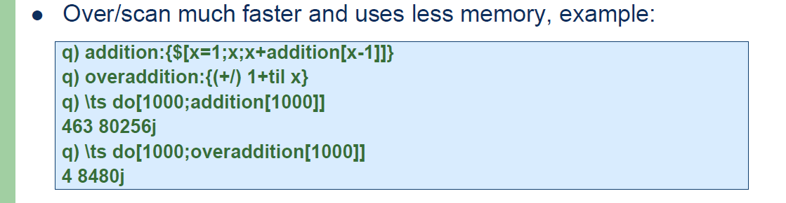
Q Basics continued…
It should not be surprising to note a simple relationship between scan and over. It is demonstrated below. Given same seed, list and function the last value of scan result is same as the result of converge function.
Ex: (5 +/0 1 2 3 4 5j)~(last 5 +\0 1 2 3 4 5j) / This returns 1b which means true. Its like proving the above statement using an example!!
Finally we wind up with simple example of polyadic version of the over adverb.
The polyadic form is : f/[ X; Y ; Z ;…..] where f is the polyadic lambda, X is a seed which could be atom or list. Y , Z , …are all equal length lists. They could also be atoms but generally are lists in most of the times.
{x+y+z}/[5; 10 20 30; 100 200 300] / gives us 665.
A useful practical example of polyadic application using over is given below.
Ex:- Assume f1:{x+2}; f2:{x*x}; f3:{(2*x)+3}; / This defines 3 lambda functions which do simple math operations.
{[x ; y ; z] y[x] }/[5;(f1;f2;f3);0N 0N 0N] / This works!! But what does it do ? It is applying successively each lambda and generating next result.
i.e f3[f2[f1[5]]] / This comes out to be 101.
A useful example below to indicate how to measure speed and memory performance of q code. It also indicates why adverbs are faster!

Slide 22
Q Basics continued…
each prior is another adverb which is quite useful. It takes form : f’:[y] where f is dyadic function , the operator is ‘: and y is generally a list.
Ex: - {x>y}’:[4 7 3 9 12 14 1 67 22] / This outputs result of : 110111010b which is a list of boolean values.
There is also a form with initial seed. It takes form : x f’: y.
Ex:- 10 { x>y} ‘:[5 6 3 2 9 8 4 5] / This outputs result of : 01001001b.
So what is going on here ? put simply the {x>y} lambda is called for two successive items in the list at index n and n-1. items at index n is passed as first parameter x and n-1 is passed as second parameter y.
If there is no seed value [ first example ] then the value is assumed to be a null type of same data as first item. Ex:- here 0Nj since 4 is a long.
Ex:- A good use case is delta generation in which we need the amount by which a stock moved today vs yesterdays closing price. It will be implemented as 0 {x-y}':4 7 9 9.5 10 12 15 17 / Give me successive delta of movement between successive days of closing stock price.
The next adverb is each right. each right as name implies, applies the function f to each element in right side which is a list. It has dyadic form. The form is : x f:/ y where x is atom , f is dyadic lambda and y is either an atom or a list.
Ex:- 2 +/: til 10 / gives 2 3 4 5 6 7 8 9 10 11j which is sum dyadic function applied with 2 as first param and each of 0 to 9 as the second items. It results in all of them bumped up by 2 which is the above result.
The last of adverbs we will discuss is each left. It is denoted by \: [ remember this as left tilting line or backslash over colon operator] . The form of this function is : x f\: y where x is atom , f is a dyadic function and y is either an atom or list.
Ex:- "anand"{"c"$("i"$x)-y}\: 32 /This is implementing upper case conversion using each left ☺ ; results in “ANAND” upper case string.
Ex:- .Q.a{"c"$("i"$x)-y}\: 32 / Give me all English alphabets in upper case ☺, Explore .Q and .z namespaces online at code.kx.com.
Note : The difference between ascii values of every letter in small case and uppercase is 32. Hence the 32 value above.

Slide 23
Q Basics continued…
We will discuss logical operators in this section. Some simple logical operators are discussed below each with two examples.
Most logical operations return boolean type values namely true ( 1b) or false (0b).
First we have equality comparison. To check if a variable value is 2 we say a=2 / This returns 1b true boolean value if true else false or 0b.
To check if a variable is not equal to 2. we can do like this. a<>2 / This gives 1b is a is indeed not equal to 2 else will return false ob.
There are other basic logical operators. See them in action via below examples.
test:{ a:10; a>1} / This returns true since a which is 10 in value is greater than 1.
test:{ a:10; a<9} / This returns false 0b, since 10 is not less than 9.
test:{ a:2; not a<>2} / This returns true since a<>2 is false and its logical not is true.
test:{ a:2; b:a+1; a<>2 and b=3} / This returns false since a<>2 is false and b=3 is true. false and with anything else will be false.
test:{ a:2; b:a+1; a<>2 or b=3} / What happened here ?
test:{ a:2; b:a+1; (a<>2) or (b=3)} / works as expected. Since b=3 is true the overall result Is 1b or true.
There is a very useful operator tilde ~ [ match operator ] which helps in comparing complex or derived type objects in q. This is very useful at times. The below example illustrates this.
t1:([] Name:`Anand`Beni`Rod; Age: 1 2 3); t2:([] Name:`Anand`Beni`Rod; Age:1 2 3); t1~t2 / This returns 1b since both tables are exactly same!
If either table has some extra data or keys then result of comparison will be 0b or false. Attributes on tables/lists are ignored in comparison. Only data in the object is compared.

Slide 24
Q Basics continued…
We will discuss in this section basic math operators. % is an aberration since in many other languages it means mod but in q it is divide by operator ☺. rest of some common operators are usual.
+ is addition , - is subtraction, * is multiplication and % is divide by operator. Each of these is given some examples below. Note that apart from atoms q also supports implicitly the same operations over lists or arrays without special syntax requirement.
test:{ a:2; b:3; a + b } / This returns 5 as expected.
test:{ a:2; a + x }; test[1+ til 10] / This returns a list from 2 till 12. What happened here ?
test:{ x-y}; test[4 5 6; 1 2 3] / This returns 3 3 3. What is happening here.
test:{ 2*x+3 }; test[5] / This returns 16. what ? How come ? We need understand the parsing and precedence if q which is different.
() is precedence operator and it plays very critical role in proper evaluation at times. The q interpreter evaluates from right to left. This is unlike other languages.
2*x+3 is evaluated from right to left as x+3 and then multiply the result by 2. But if we wanted left to right we need parenthesis.
test:{ (2*x)+3 }; test[5] / This returns 13 as expected.
Sometimes this can be hard to debug! So how do we go about this ? Do we parenthesize everything ? No. over parenthesizing is protective and inefficient programming in q and can have a performance penalty. So we need to choose parenthesis minimally only where required.
The above example we could also solve like this. test:{ x:2*x; x+3 }; test[5] / This returns 13 as expected and no issue of parenthesis at all.
There are genuine cases where parenthesis can not be avoided. In places where expected result is not in line there is a tool that comes to rescue. It is called parse command. It takes your q expression and tells how q will token by token parse it and evaluate it.
parse “2*x+3” / This command will parsed tokens and priority of evaluation.

Slide 25
Q Basics continued…
There are quite a few special operators in q. Covering all of them is not possible. Here we introduce the most commonly used ones. Rest are left as exercise to explore for the reader. Refer to https://code.kx.com/v2/ref/ operators section for exhaustive list.
@ operator is either of these operations. Index/apply/trap. What multiple meanings to a single operator ? Yes many operators are overloaded in q. Based on expression and data type passed q interpreter will evaluate and choose the correct context.
d:((1 2 3; 4 5 6 7); (8 9; 10; 11 12); (13; 14; 15 16 17 18; 19 20)); / This is list of list of lists.
d@1 2 / Give me first and second index of array d results in ((8 9;10;11 12);(13 14;15 16 17 18;19 20))
f:{ x+42 }; f@42 / This gives 84 same as f[42] in meaning.
@[value; `Anand+42; `errorInExpression] / This traps a invalid expression evaluation and returns the symbol ` errorInExpression.
Next we move to $ operator which has atleast 5 different overloads i.e different meanings based on context. We will discuss only a few here.
convert integer into float p:$[`int;42j] / Results in p being assigned a float of value 42f.
test:{ name : ”anand”; 10$name}; test[] / This results in 10 spaces padded to “anand” string towards the end.
$[`float; 1 2 3 4j] $ $[`float; 5 6 7 8j] / This demonstrates both cast and dot product of $ operator in same command. result is 70f.
Exclamation ! Operator stands for dict/update/delete. It separates the list of keys and list of values in a dictionary.
Ex:- (`anand`peter`thomas)!(10 20; 20 30; enlist 40) / This is multimap because each key holds a list of values not just single atom value.
Functional table update and delete are done via ! Operator. A basic example illustrates this below.
delete from tbl where name=`Anand is same as below functional forms.
tbl:([] Name:`Anand`Peter`Thomas; Age:10 20 30);
![tbl;enlist (=;`Name;enlist `Anand);0b;0#`] / This deletes table data and displays resulting table without modifying the original tbl table.
![`tbl;enlist (=;`Name;enlist `Anand);0b;0#`] / This deletes table data and modifies the original tbl table. One backtick on table name can make world of difference!!
Next we will explore ? operator. It has 4 different overloaded meanings find/rand/select/exec. We will discuss a few and leave rest to reader to explore online using q reference manual.

Slide 26
Q Basics continued…
? Operator can be used to do linear lookup i.e search for a given value in a list. It will return the index of the item if found. If no match is found then it returns the size of the list which means whole list was traversed index by index but nothing was found matching.
2 3 4 5 6?5 / This returns 3 since the value 5 is found at index=3 in the list.
2 3 4 5 6?8 / This returns 5 indicating no match was found equal to 8 in the list.
Next we explore the rand operation which is very useful in generating random number lists and playing with them.
20?5 / This means give me a list of random numbers from 0 to 4 with list size being 20.
10?`4 / Give me a list of symbols each of size 4 characters in it and list size should be 10.
4?0Ng / Give me a list of GUID list size being 4.
? also can be used to implement functional select on tables. Functional select forms allow one to construct query on the fly and execute it.
tbl:([] Name:`Albert`Peter`Thomas; Age:10 20 30; Salary:100 200 300);
?[tbl;enlist ((';~:;<);`Salary;150j);0b;{x!x} `Name`Age] / This is same as parse "select Name, Age from tbl where Salary>=150"
~ match or tilde operator is comparison operator for complex or derived type objects. It has been discussed earlier in previous section.
# is take operator. It says take something out from an object. Below examples indicate how It can be used.
List:1 2 3 4 5; 2#List / This gives 1 2j. This is saying give me 2 items of the list from beginning.
-2#List / This gives us last two items of the list.
When the same is applied to tables it gives rows from either beginning or end. Ex:- tbl:([] Name:`Anand`Peter`Thomas; Age:1 2 3); 2#tbl gives first two rows as a table.
_ underscore is a cut or drop operator in q. It can be used to cut arrays at specific indices or remove specific elements.
5_0 1 2 3 4 5 6 7 8 / drop the first 5 (leaving the last 4)
-5_0 1 2 3 4 5 6 7 8 / drop the last 5 (leaving the first 4)
0 1 2 3 4 5 6 7 8_5 / drop the 5th item (leaving everything else)
0 3 7_0 1 2 3 4 5 6 7 8 / cut at indices 0, 3 and 7
^ is coalesce or fill operator. It can replace null with a given value in list.
0^1 2 3 0N / This results in 1 2 3 0 , see that null 0N is replaced with 0 which is supplied value.

Slide 27
Q Basics continued…
Casting is converting data from one type to another. Sometimes it is necessary to do this since the operation you want to run does not work on input data type. Below we will see some examples and then explore a small example to apply this.
test: { `$[float ;x ] }; test[5j] / this converts passed long 5j into float value 5f. It can also be done using command “f”$x;
test: {"f"$x}[5j] / same as above but casting is done via use of $ operator using datatype short hand “f” which stands for float.
{ `$x }[“anand”] / converts “anand” which is a string to `anand which is a symbol. What is the difference ? Both look same except ` backtick.
{ "i"$x }["anand"] / This produces result of 97 110 97 110 100i , what is that ?
{ x $ y }[1 2 3 4j; 5 6 7 8j] / This does not work. Why and what is the fix ?
How do I know what the is long and short hand form of all datatypes ?
flip{(x;.Q.t x;key'[x$\:()])}5h$where" "<>20#.Q.t / This will get Q help on all shorthand and long hand forms of different data types i.e atoms.
{ “b”$x }[1 2 3 4 5 6 0] / This gives us 1111110b which is a list of boolean parameters.
We will do a small exercise below. Given a table write a lambda to add another column to this table with a boolean value. If the name contains letter “e” then it should be 1b else 0b. Then write a functional select query to select the names from table which have 1b value.
tbl:([] Names:`Anand`Peter`Beni`Thomas`Nick`Bianca`WenHao);
solution : TODO ?
change the above solution to add a new column which has count of given letter “e” or specific character as input. The count can be assumed to be int type.
Solution : TODO ?

Slide 28
Q Joins.
In this last part of the fundamental series we will deal with joins. as joins are very critical and important writing effective qSQL involves good understanding of joins. Q provides powerful types of joins apart from traditional joins that are present in other programming languages.
The special joins are make q powerful and better choice than other traditional databases for time series data are joins involving timestamps which can go up to nano second precision in highly frequent data [ very deep liquid market data ].
Some critical aspects about using joins in q are.
The developer must be able to identify based on given situation which join serves the need best ?
When there are multiple ways to achieve the result, backtest the performance of code using \t and \ts to decide the best performing one.
Use different type of joins to achieve the results [ i.e mix and match ].
Below are some important types of joins in q. We will discuss each of them with one example.
lj [ left join ]. / ljf
ej [ equi join ]. / there is no full equivalent here.
ij [ inner join ] / ijf
pj [ plus join ] /
uj [ union join ] / ujf
upsert
comma join [ , operator ]. / discuss ,’ eachboth [ side by side record join ].
coalesce join [ ^ coalesce/fill operator ].
Timestamp based joins [ advanced and very useful ].
aj, aj0 [ as of joins ]
wj, wj1 [ window join ].
We will first start with left join which is the most common kind of join used frequently in q.

Slide 29
Q Joins continued…
The first join is most commonly used join in q. It is called left join. Below we demonstrate this concept using a simple example. All the characteristics of this join are listed below. Read each of them carefully and understand using the example.
Left join has the form : t1 lj t2
t1:([] Name:`Anand`Peter`Robert; Age:1 2 0N; Location:`IN`SG`UK);
t2:([] Name:`Anand`Albert`Thomas`Robert`Anand; Age:3 4 5 6; Salary:10 20 30 40 50);
t1 lj t2 / Gives error since right side table t2 needs to be keyed. atleast one column must be common with t1 and should be part of the key.
t1 lj `Name xkey t2 / Fine now but t2 is unaffected since key is applied only the fly.
Very critical details of left join are detailed below as q comments. Read and apply each of them in the above example.
/ t1 is either keyed or can be unkeyed
/ t2 or second table to the right side must be keyed.
/ There must be atleast 1 common column between both the tables. That column must be part of the key in second table.
/ The resulting table.
/ a. has 1 row for each row of the table t1.
/ b. aims to match using the key every record in t1 to first record in t2 that matches the key.
/ c. if t2 table has a missing record when matched by key in table t1. Then new columns coming from t2 have null values.
/ d. If the column is common between t1 and t2 the t2 values will update the t1 values after the join. Ex:- Age of Anand is 3 now from 1.
/ e. resulting table is unkeyed if t1 is unkeyed. else the keys of t1 are retained on result if it is also keyed.
/ f. If the second table t2 has multiple rows matching by key to t1 the first row / occurrence values are chosen always.
/ verify this using this line of code. `Name`Location xkey t1 lj `Name xkey t2 / Fine now but t2 is unaffected since key is applied only the fly.
Exercise : Solve the below problem using joins to provide a list of employees who are above age of 50 and have salary greater than 150. Return the result as a List.
t1: ([] Name:`Anand`Peter`Beni`Thomas`Rod`Michael; Age:10 20 55 45 60 70);
t2 : ([] Name:`Anand`Peter`Beni`Thomas`Rick`Rod`Michael`Jacob; Salary:100 170 160 140 135 175 500 97);
TODO solution : XXX ? Solve this and discuss any doubts. Also try to use functional form of select if possible ☺

Slide 30
Q Joins continued…
What is the difference between lj and ljf ? ljf is left join full where in the null values in table t2 will not update the values in table t1 if the column is common , it is selected as part of join result and it is available by join key. Below example demonstrates this.
t1:([] Name:`Anand`Peter`Robert; Age:1 2 0N; Location:`IN`SG`UK);
t2:([] Name:`Anand`Albert`Thomas`Robert`Anand; Age:3 4 5 6; Salary:10 20 30 40 50);
t1 lj `Name xkey t2 / This is normal left join.
t1 ljf `Name xkey t2 / This is full left join.
The other optional form of left join that can be used is : lj[t1;t2] or ljf[t1;t2].
We next move to equi join. As the name indicates it is a join based on equality of values compared for a given set of columns that are common to both tables. We will understand the join through below example.
t:([]sym:`IBM`FDP`FDP`FDP`IBM`MSFT;price:0.7029677 0.08378167 0.06046216 0.658985 0.2608152 0.5433888; tick:1 2 3 4 5 6);
s:([]sym:`IBM`MSFT;ex:`N`CME;MC:1000 250);
ej[`sym;t;s] / The sql equivalent of this is : select a.sym, a.price, a.tick, b.ex, b.MC from t a, s b where a=sym=b.sym; dont run this it does not work.
The below are critical properties to note in the equi join.
There is no key requirements on either table in equi join. Only criteria is they have atleast 1 common column by which record to record can be compared for equality.
The resulting table is always unkeyed even if both the tables involved are keyed.
If common columns are there in both table the values in result are updated from t2.
all columns from t1 and t2 are selected in result.
We now move to the third critical join to discuss namely the inner join. Inner join is similar in most ways to left join. Although there is a small difference ? Can you spot the difference here ? Use below example to see results of joins. Discuss this in detail.
t1:([] Name:`Anand`Peter`Robert; Age:1 2 0N; Location:`IN`SG`UK);
t2:([] Name:`Anand`Albert`Thomas`Robert`Anand; Age:3 4 5 6 1; Salary:10 20 30 40 50);
t1 lj `Name xkey t2 / using left join.
t1 ij `Name xkey t2 / using inner join.
A corresponding full version is available as ijf , reader is requested to explore this via an example in the class.

Slide 31
Q Joins continued…
We next deal with plus join which is a numerical join [ because plus makes sense only for numerical types ]. This is a special case of left join where in the common column values for each matched record between first and second table are added rather than replaced with values of second table t2. see the below example to understand this better.
/ Initialize the tables as below.
t1:([]a:1 2 3;b:`x`y`z;c:10 20 30);
t2:([a:1 3;b:`x`z]c:1 2;d:10 20);
/ check values using the below variables.
t1
t2
/ Plus join is below.
t1 pj t2 / or one can use pj[t1;t2]
We move to union join. union join is row by row join of two tables. If both tables have matching key columns then results in first table t1 are updated with values from t2. If there are no keys then its fine , we will just insert the rows from t2 (into the result combining with t1).We explore via the below example.
/ Example1 : both are keyed tables.
t1:([a: 1 2 3]; b: 4 5 6; c:7 8 9);
t2:([a: 1 2 5]; b: 10 20 30; d:100 200 300);
t1 uj t2
/ Example2 : both are non keyed tables.
t1:([]a:1 2;b:2 3;c:5 7);
t2:([]a:1 2 3;b:2 3 7;c:10 20 30;d:"ABC");
t1 uj t2
Discuss the above examples and identify where union join would be helpful.

Slide 32
Q Joins continued…
The next join to discuss would be upsert. Upsert keyword is a short cut for update and insert. It means where ever possible by key update the data in the first table with matching rows in second table but if second row data does not match any row by key then simply insert it like we did in union join. Below we will see examples for this.
/ Example1. We discuss both tables have common key.
t1:([a:1 2 3 4]; b:5 6 7 8);
t2:([a:1 2 3 10]; b:11 22 33 44);
t1 upsert t2
/ Example2. The first table is keyed and second table can be unkeyed.
t1:([a:1 2 3 4]; b:5 6 7 8);
t2:([] a:1 2 3 10; b:11 22 33 44);
t1 upsert t2
/ Example 3 : error here if t1 is unkeyed and t2 is keyed.
t1:([] a:1 2 3 4; b:5 6 7 8);
t2:([a:1 2 3 10]; b:11 22 33 44);
t1 upsert t2 / Error , how will you solve this ?
/ Example 4: both are unkeyed then it is fine. Simply merge both the table rows. But schema has to be same for both.
t1:([] a:1 2 3 4; b:5 6 7 8);
t2:([] a:1 2 3 10; b:11 22 33 44);
t1 upsert t2
The next join is comma join or side by side join. Two tables can be side by side joined provided they have same number of rows. If columns are different they are simply added side by side. If columns repeat then the most recent repeat from the rightmost table is picked along with it column type. see the below examples.
t1 , t2 behaves same as t1 upsert t2.

Slide 33
Q Joins continued…
The below is examples illustrates the comma join. Multiple scenarios are demonstrated here.
/ Initialize the tables as below.
t1:([] Name:`Anand`Peter`Thomas);
t2:([] Age: 1 2 3);
t3:([] Salary:100 200 300);
t4:([] Name:`Anand`Peter`Jill);
t5:([] Salary:100 200 300f);
/ Try these.
t1,'t2,'t3
t1,'t2,'t3,'t4
/ Can be better written as below using over.
t1(,')/(t2;t3)
t1(,')/(t2;t3;t4)
meta t1(,')/(t2;t3;t4;t5)
We move on to the next join. coalesce join. Both t1 and t2 are keyed tables below example. Merges them!
/Example1.
t1:([a:1 2 3 4]; b:10 20 30 40);
t2:([a:1 2 7 8]; b:11 12 13 14; c:100 200 300 400);
t1^t2
/ TODO : Reader : Experiment and explore the tables by removing keys from them. Left as excercise for class to do.
Note : The performance of ^ is slower than that of , since each column value of the right operand must be checked for null.

Slide 34
Q Joins continued…
Finally there are two joins that are truly unique to q. They are timestamp based joins. Specifically allow faster performance of joins compared to traditional sql and noSQL databases. Ideal for timeseries database.
These joins are namely as of join and window join.
We will first start with as of join example and indicate why it is needed first of all [ need is the mother of invention ☺ ].
The trader from desk asks IT Guy Jack to see if it is possible to find the quote which is nearest before or at the time for a give trade. He gives you data for both trade and quote in spreadsheet along with timestamps. The IT guy manually tries to take each trade and its timestamp. Then he filters the quote table by the same criteria and identifies the last record before or at the trade timestamp. Since the quote data is very large he ends up spending full day doing this analysis. Trader is upset because he wants the answers real fast.
Jack ends up discussing his difficult day with Jill at coffee hut. Jill happens to be kdb+ developer and starts smiling at Jack as he explains. Jack wonders what wrong with Jill. Jill says you need as of join ☺. Jack is stunned!
Let us take an example to understand the as of join below.
trade:([]time:10:01:01 10:01:03 10:01:04;sym:`msft`ibm`ge;qty:100 200 150);
trade
time sym qty
------------------------
10:01:01 msft 100
10:01:03 ibm 200
10:01:04 ge 150
quote:([]time:10:01:00 10:01:00 10:01:00 10:01:02;sym:`ibm`msft`msft`ibm;px:100 99 101 98);
quote
time sym px
------------------------
10:01:00 ibm 100
10:01:00 msft 99
10:01:00 msft 101
10:01:02 ibm 98
aj[`sym`time;trade;quote]
time sym qty px
-------------------------
10:01:01 msft 100 101
10:01:03 ibm 200 98
10:01:04 ge 150

Slide 35
Q Joins continued…

Slide 36
Q Joins continued…

